Slide 1
WisTMP 2.0 Update
Andy Heidtke, PE
Statewide Work Zone Design Engineer
Please mute your microphone
Email your questions
March 7th, 2019

Slide 2
WisTMP 2.0 Update

Slide 3
WisTMP Goals
Streamline data entry
Form redesign
  Reduced to 10 sections
  Form adjusts based on inputs
Simplify data mining
One system for work zone design approvals

Slide 4
WisTMP 2.0 Update Overview
Form updates
Form functionality
New data fields
New notes for requested attachments
Reduction to 3 TMP types

Slide 5
TMP Types
Based on potential for delay
Type 3 – These will typically be mega and major projects, multi-year
Type 2 – Projects that will impact travel with potential for delay
Type 1 – Projects that will not impact travel and will not cause delay
Notes:
Most project will be Type 2

Slide 6
WisTMP 2.0 New Information
Existing Conditions
Additional Strategies
Road User Costs
Law Enforcement Mitigation
Non-Standard Mitigation Form

Slide 7
WisTMP Form Updates

Slide 8
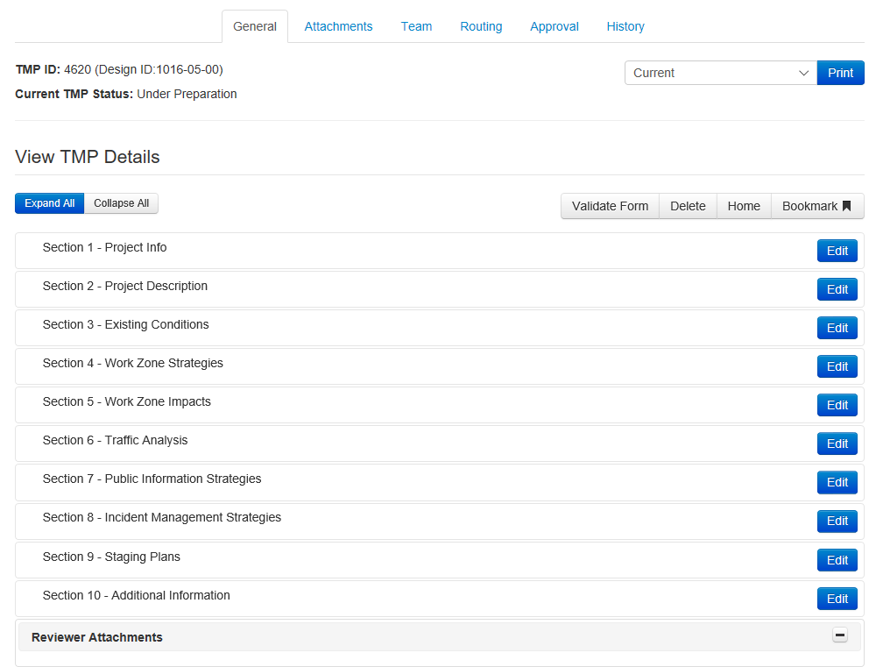
Notes:
Here is the new form showing the new 10 sections. Another change is at the top of the image, there is no longer a Checklist tab.

Slide 9
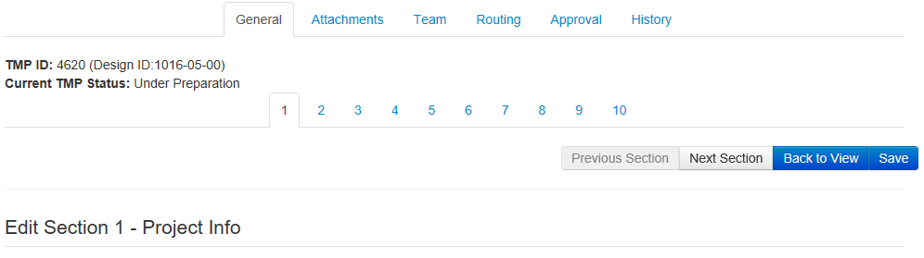
Navigation Updates
Notes:
One of the changes that was made within the edit mode, is the addition of the direct links to different sections under the TMP status. The system will ask you if you would like to save when moving to different section.

Slide 10
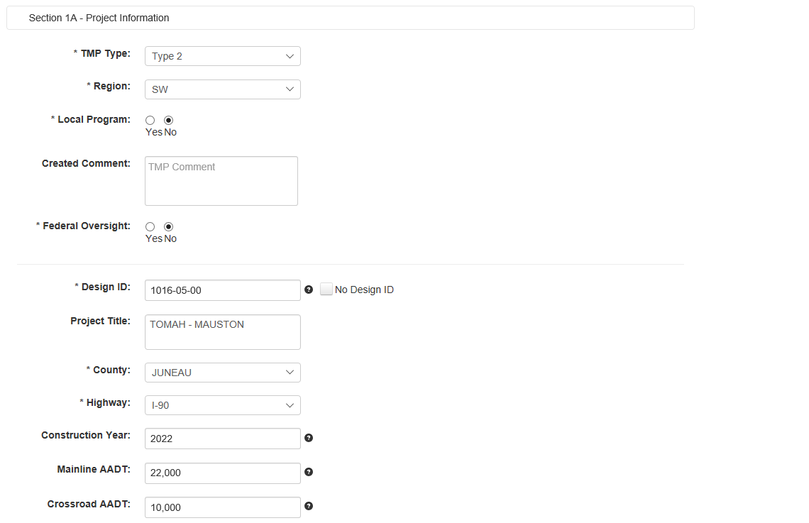
Moved from Construction Information
Moved from Construction Information
Moved from Construction Information
New Field
Notes:
New form
10 sections only
Sections 1 and 2 remain primarily the same

Slide 11
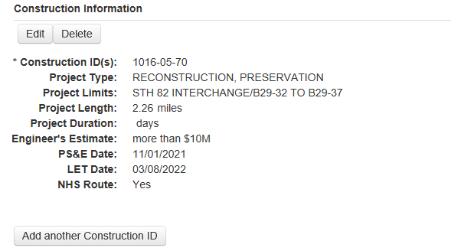
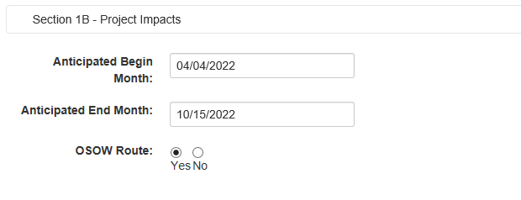
Expected Delay was removed from Section 1B
Notes:
The only additional field that was removed is Expected Delay.

Slide 12
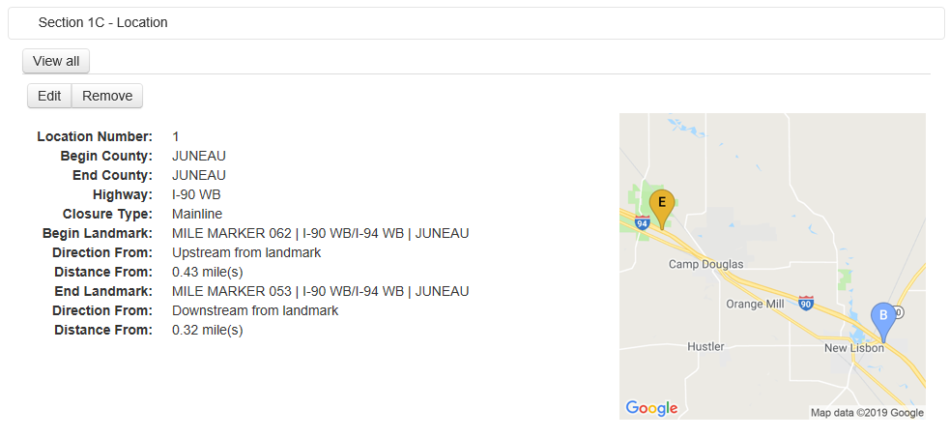
Notes:
Section 1C remains the same. However this section drives the TMP and a lot of the functionality. Section 6 depends on what is entered here. If the project impacts both directions add begin and end markers for each direction of travel. If ramps are impacted add each ramp location as well.

Slide 13
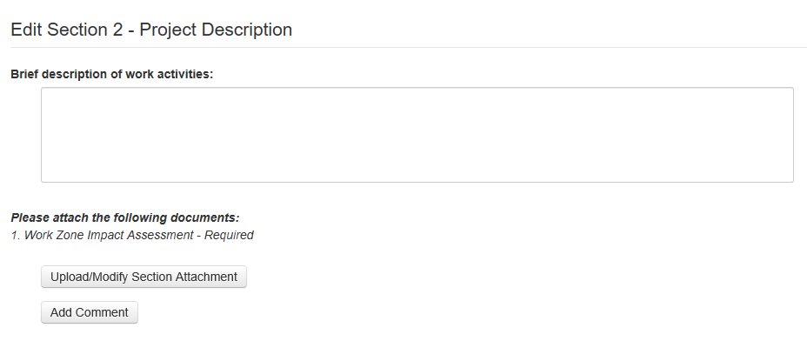
Notes:
The most significant change to Section 2 is the requirement to add the WZIA. The WZIA should be done before the TMP starts. Section 2 is meant to give someone an idea of what the project is trying to accomplish. This is not were the staging plan should be.

Slide 14
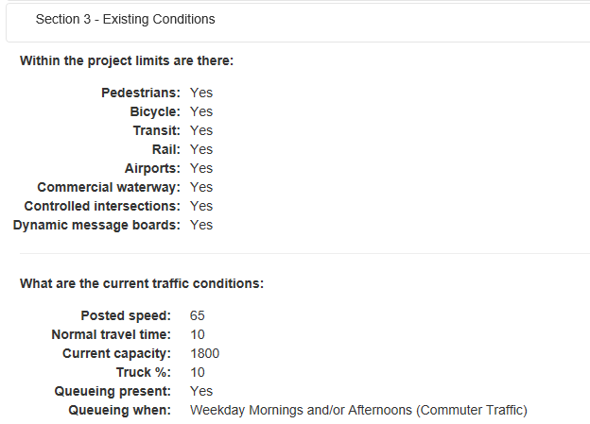
All fields are new to TMP 2.0
Notes:
Includes existing conditions prior to construction
This section helps populate later sections, primarily section 5
The section also asks for the traffic data to be attached here

Slide 15
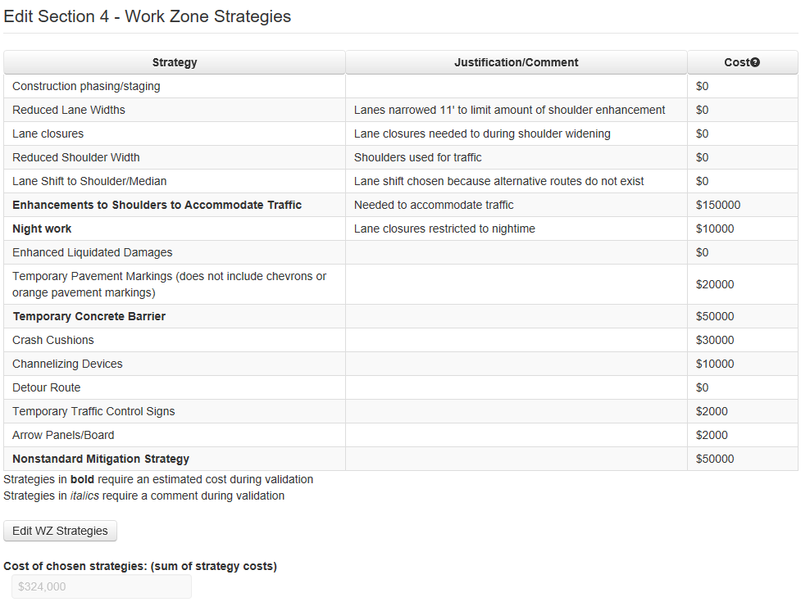
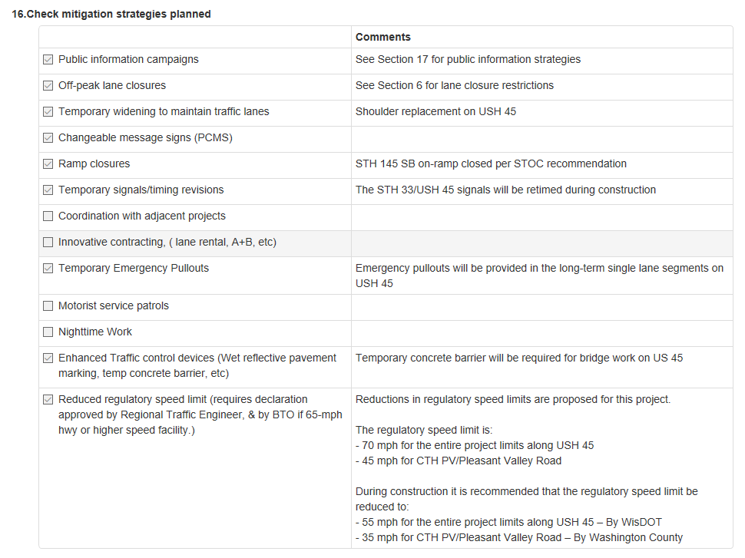
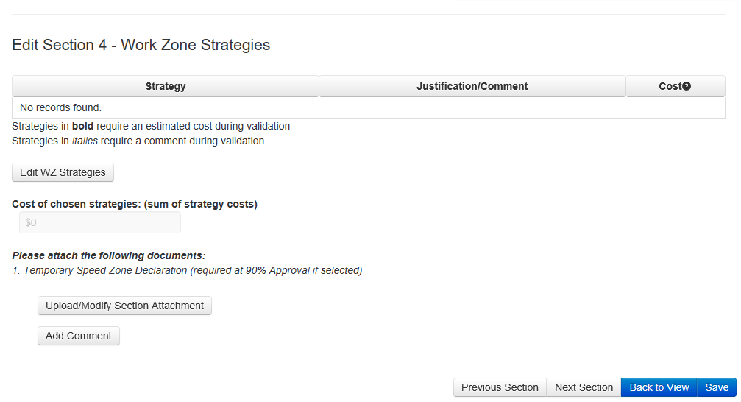
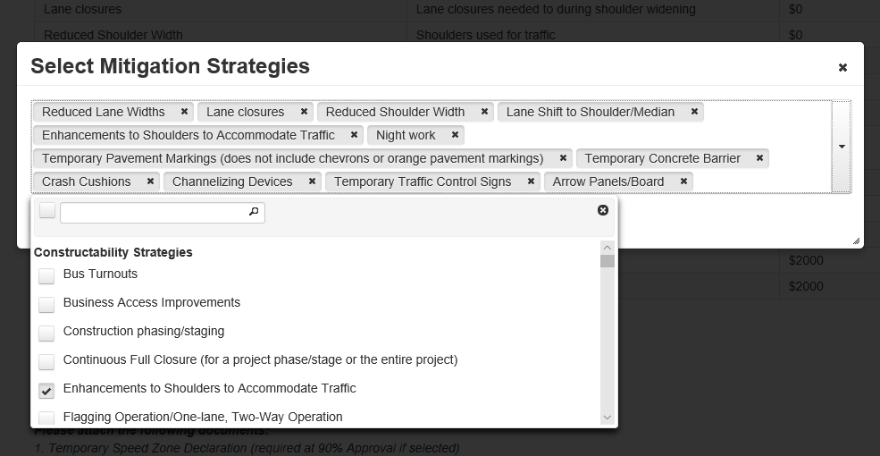
Notes:
In the previous version of the TMP System we had Section 16 to list the different strategies used on the TMP. Now the strategies have been moved to Section 4 and users select the specific strategies they are going to use on their project. There is a column for Justification/Comments for the strategy. Also new is the cost column. This is to keep track of how much each project is estimated to spend on traffic mitigation. The cost is only supposed to be a planning level estimate but can get closer to the real value as the project move forward.

Slide 16
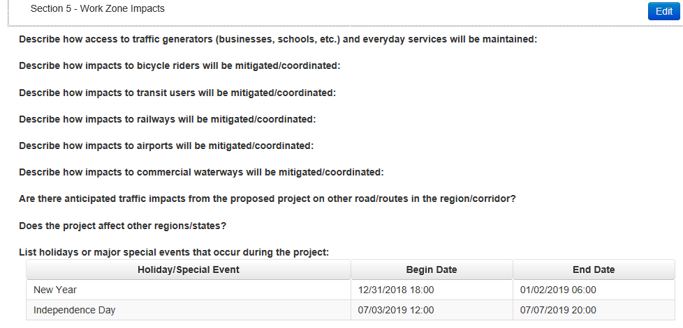
These fields depend on the answers given in Section 3.
Notes:
Section 5 changes based on what is entered into section 3. The first and last three questions are always present. Attach any documents that relate to this section. The holidays and special events is now in table format now. This is for potential interface with LCS.

Slide 17
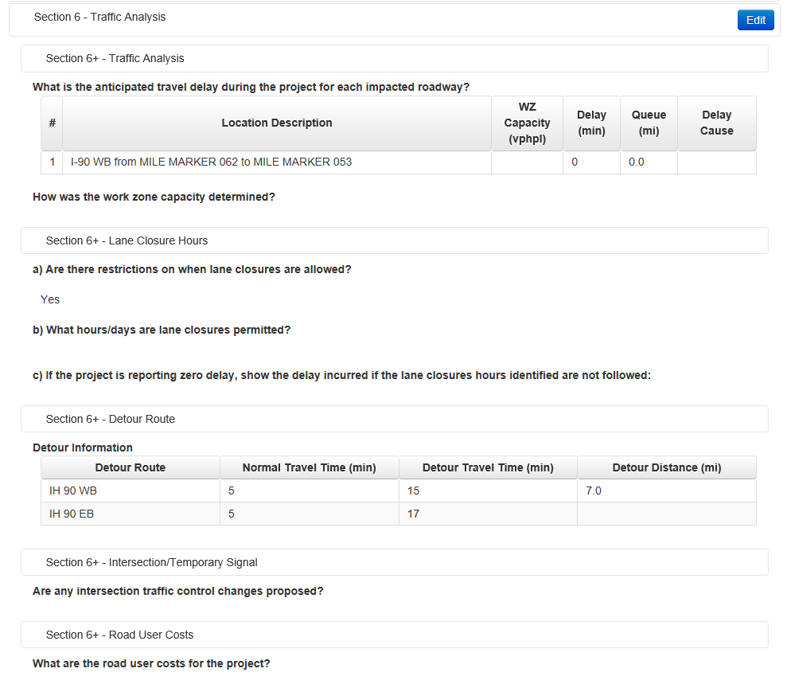
Notes:
No longer will project teams have to report traffic analysis in multiple locations. Section 6 will be the only place they are located.
Traffic Analysis is the same as the current system and is based on the locations entered in section 1C. Each location should have something entered in here, as the Decision Support Tool uses this information for its analysis.
Lane Closure Hours –We ask that projects not implement lane closure restrictions until there is delay.
Detour Information – this is for projects to enter traffic information related to detours in a tabular format.
Intersection Traffic Control – This shows up if there are signals being impacted or temporary signals being used, based on what is entered in Section 3 and 4.
Road User Costs – Currently Road User Costs are calculated right before PSE. Now we want that information much earlier and we want it to be part of the TMP.

Slide 18
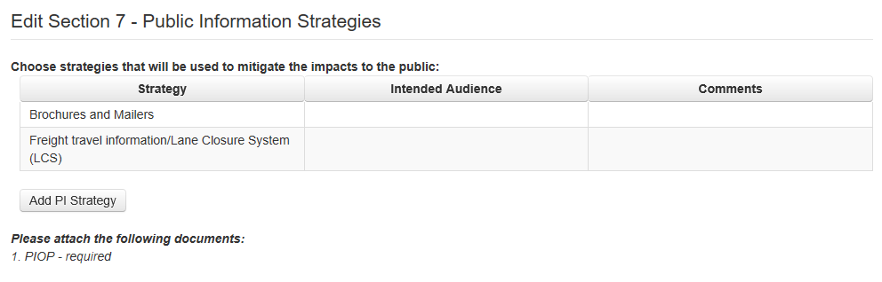
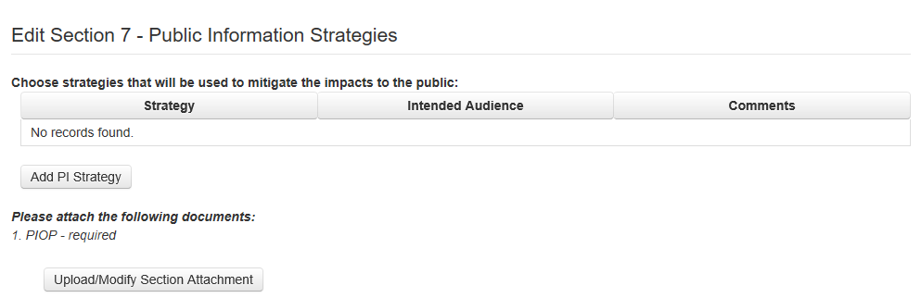
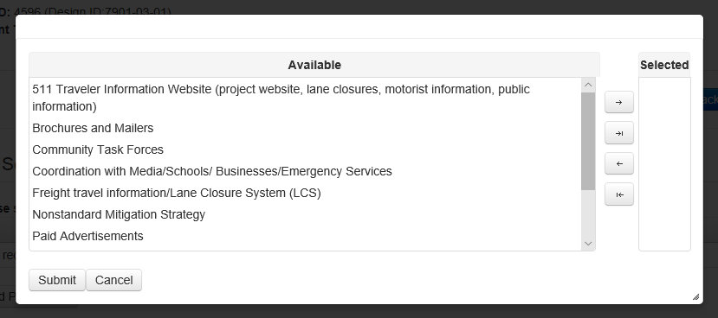
Notes:
Section 7 is similar to Section 4 in which the users select the strategies.

Slide 19
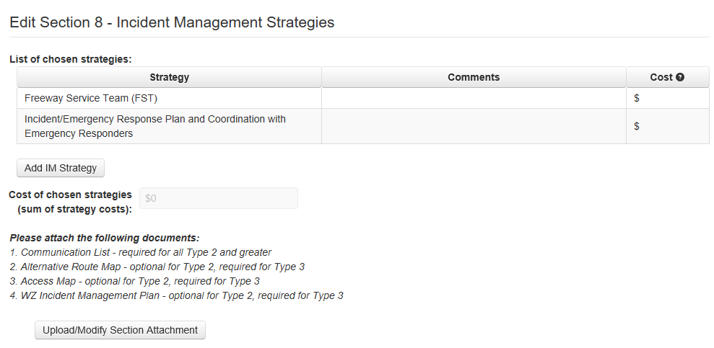
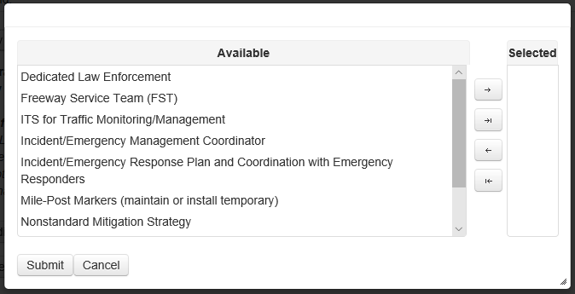
Notes:
Section 8 is similar to Section 7 in how strategies are selected.

Slide 20
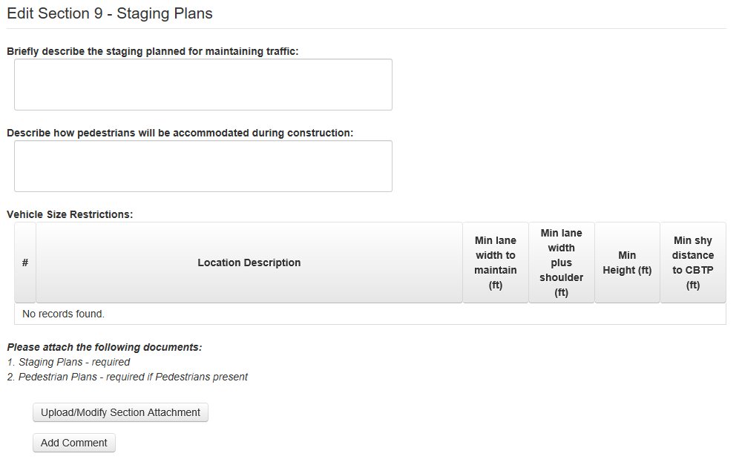
Only if Pedestrian yes in Section 3
Notes:
Please be brief when describing the staging plans. We are not looking for a written version of the staging plan, we are looking for a supplement that describes why the staging plan has been developed that way.
If pedestrians are on the project we want to see a pedestrian staging plan
The vehicle size restrictions are for describing the minimum restriction at each location entered into Section 1

Slide 21
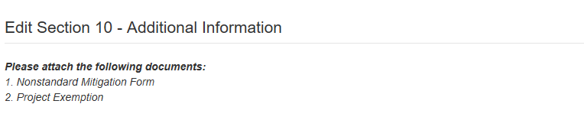
Notes:
When the Nonstandard Mitigation strategy is checked in Section 4 the project will be required to fill out the “Request for non-standard mitigation strategies approval” and submit it with the TMP. The form then needs approval from the BTO Director, BTO Traffic Engineering and Safety Section Chief, and two other Regional Chiefs not involved in the project.
If a project exemption is used for greater than the 15 minute delay attach it to this section.

Slide 22
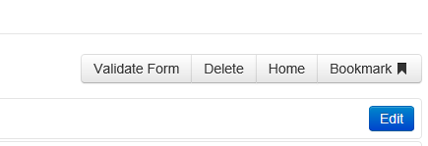
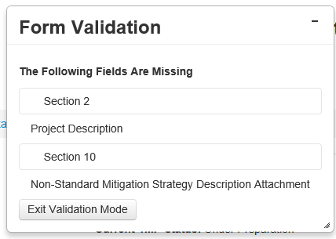
Form Validation
Notes:
New to the form is a Validate Form button. When this is pressed a pop up box will show what needs to be completed before the form can progress to the next level. The form will also self validate when the PM attempts to advance the TMP. This feature was added to prevent incomplete TMPs from being advanced.

Slide 23
WisTMP Updates
WisTMP will now be home to all Temporary Speed Zone Declarations
Road User Cost analysis must be included in the TMP if a project is going to use alternative contracting, Lane Rental, etc.
Non-standard mitigation strategies need approval from multiple Chiefs
Update will be completed March 20th, 2019

Slide 24
BTO Routing
The following will send the TMP to BTO for Approval
Type 3 TMP
Federal oversight
Innovative contracting methods
Temporary speed declaration on the interstate system
Temporary speed declaration on routes with normal speed >= 65 mph
Law enforcement mitigation
Nonstandard mitigation strategies

Slide 25
Work Zone Data
WisTMP/WisLCS are WisDOT tools for collecting work zone data
This data is used to help develop new policy
The data can also be merged with other data sources to help make project level decisions
  The recently completed Decision Support Tool assists Regional Work Zone Engineers in determining the use of a Queue Warning System

Slide 26
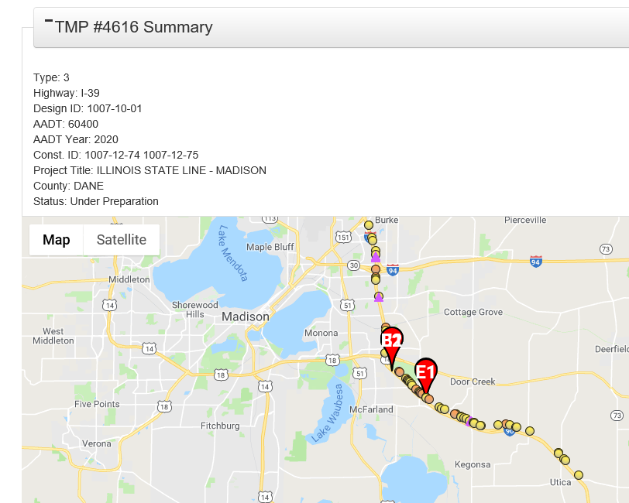
Notes:
Here is a view of the Decision Support Tool, The dots are crashes and the triangles show where a substandard curve is.
This system helps in determining where a Queue Warning System might be useful. The system uses information from the TMP site and MV4000.

Slide 27
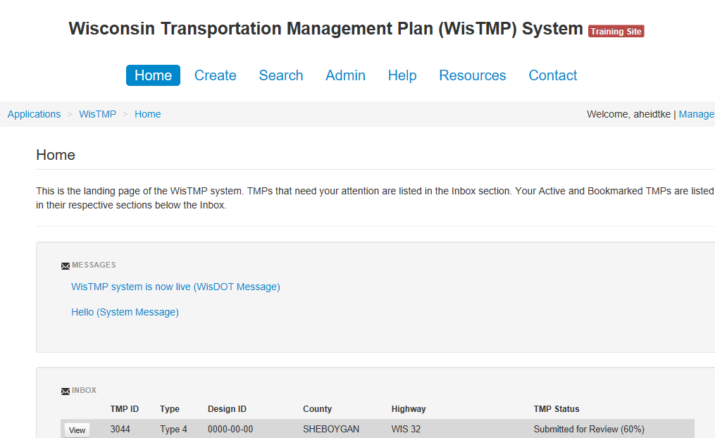
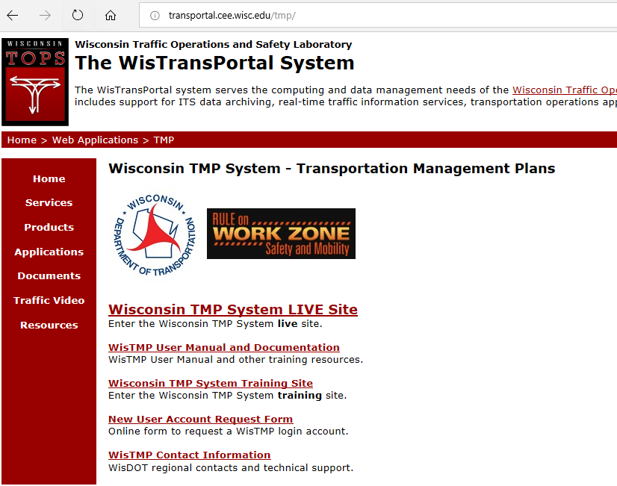
Notes:
The new TMP can be viewed on the training site

Slide 28
Let me know if you need to be added to the training site.

Slide 29
What will happen to TMPs create before the update?
Nothing
TMPs created before the update takes place will remain the same, this includes routing. Only TMPs created after the update will have the new form and routing.

Slide 30

Questions?
Contact Information
  TOPS Lab Support
  wistmp@topslab.wisc.edu
  Andy Heidtke
  Statewide Work Zone Design Engineer
  andrew.heidtke@dot.wi.gov
  414-322-4185
Notes:
If I am not available send an email to the support site

